Slide 1
Green Propellant Thrust Stand
Team 517
Jeffrey Hill, Aidan Hoolihan, Ryan Kaczmarczyk,
Nicholas Jensen, Edward Zapert
03/25/2025

Slide 2
Team Sponsors & Advisors
Edward Zapert
Marshall Space Flight Center
Sponsors:
Advisors:
Ebony Bland
Aerospace Engineer
Nicole Vaughn
Liquid Propulsion Engineer
Alexandre Berger, Ph.D.
Assistant Professor
Shayne McConomy, Ph.D.
Professor

Slide 3
Team Introductions
Edward Zapert
Jeffrey Hill
Thermal Fluids Engineer
Nicholas Jensen
Manufacturing Engineer
Edward Zapert
Design Engineer
Aidan Hoolihan
Materials Engineer
Ryan Kaczmarczyk
Controls Engineer

Slide 4
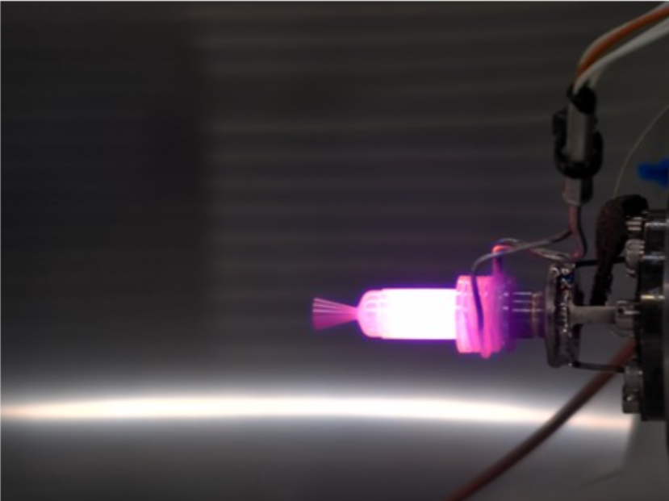
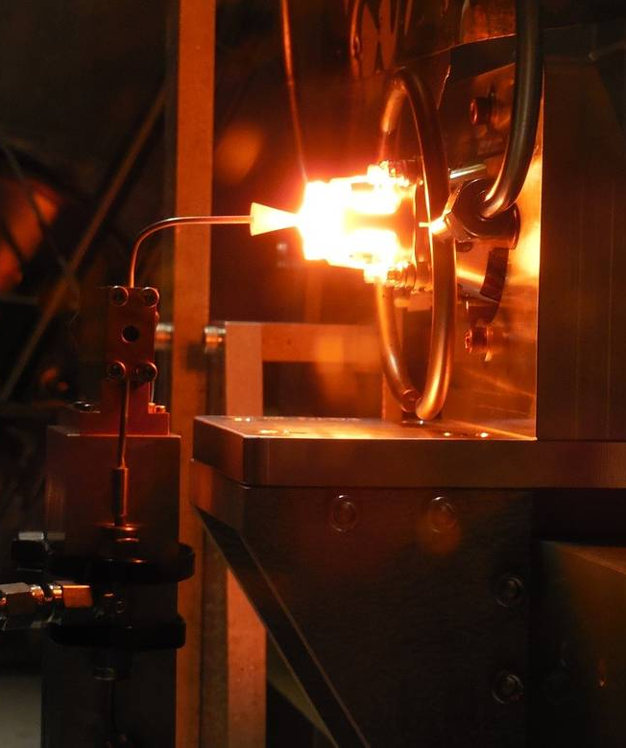
Objective
Edward Zapert
The objective of this project is to develop a thrust stand that can take accurate measurements of a 0.1N green propellant thruster.

Slide 5
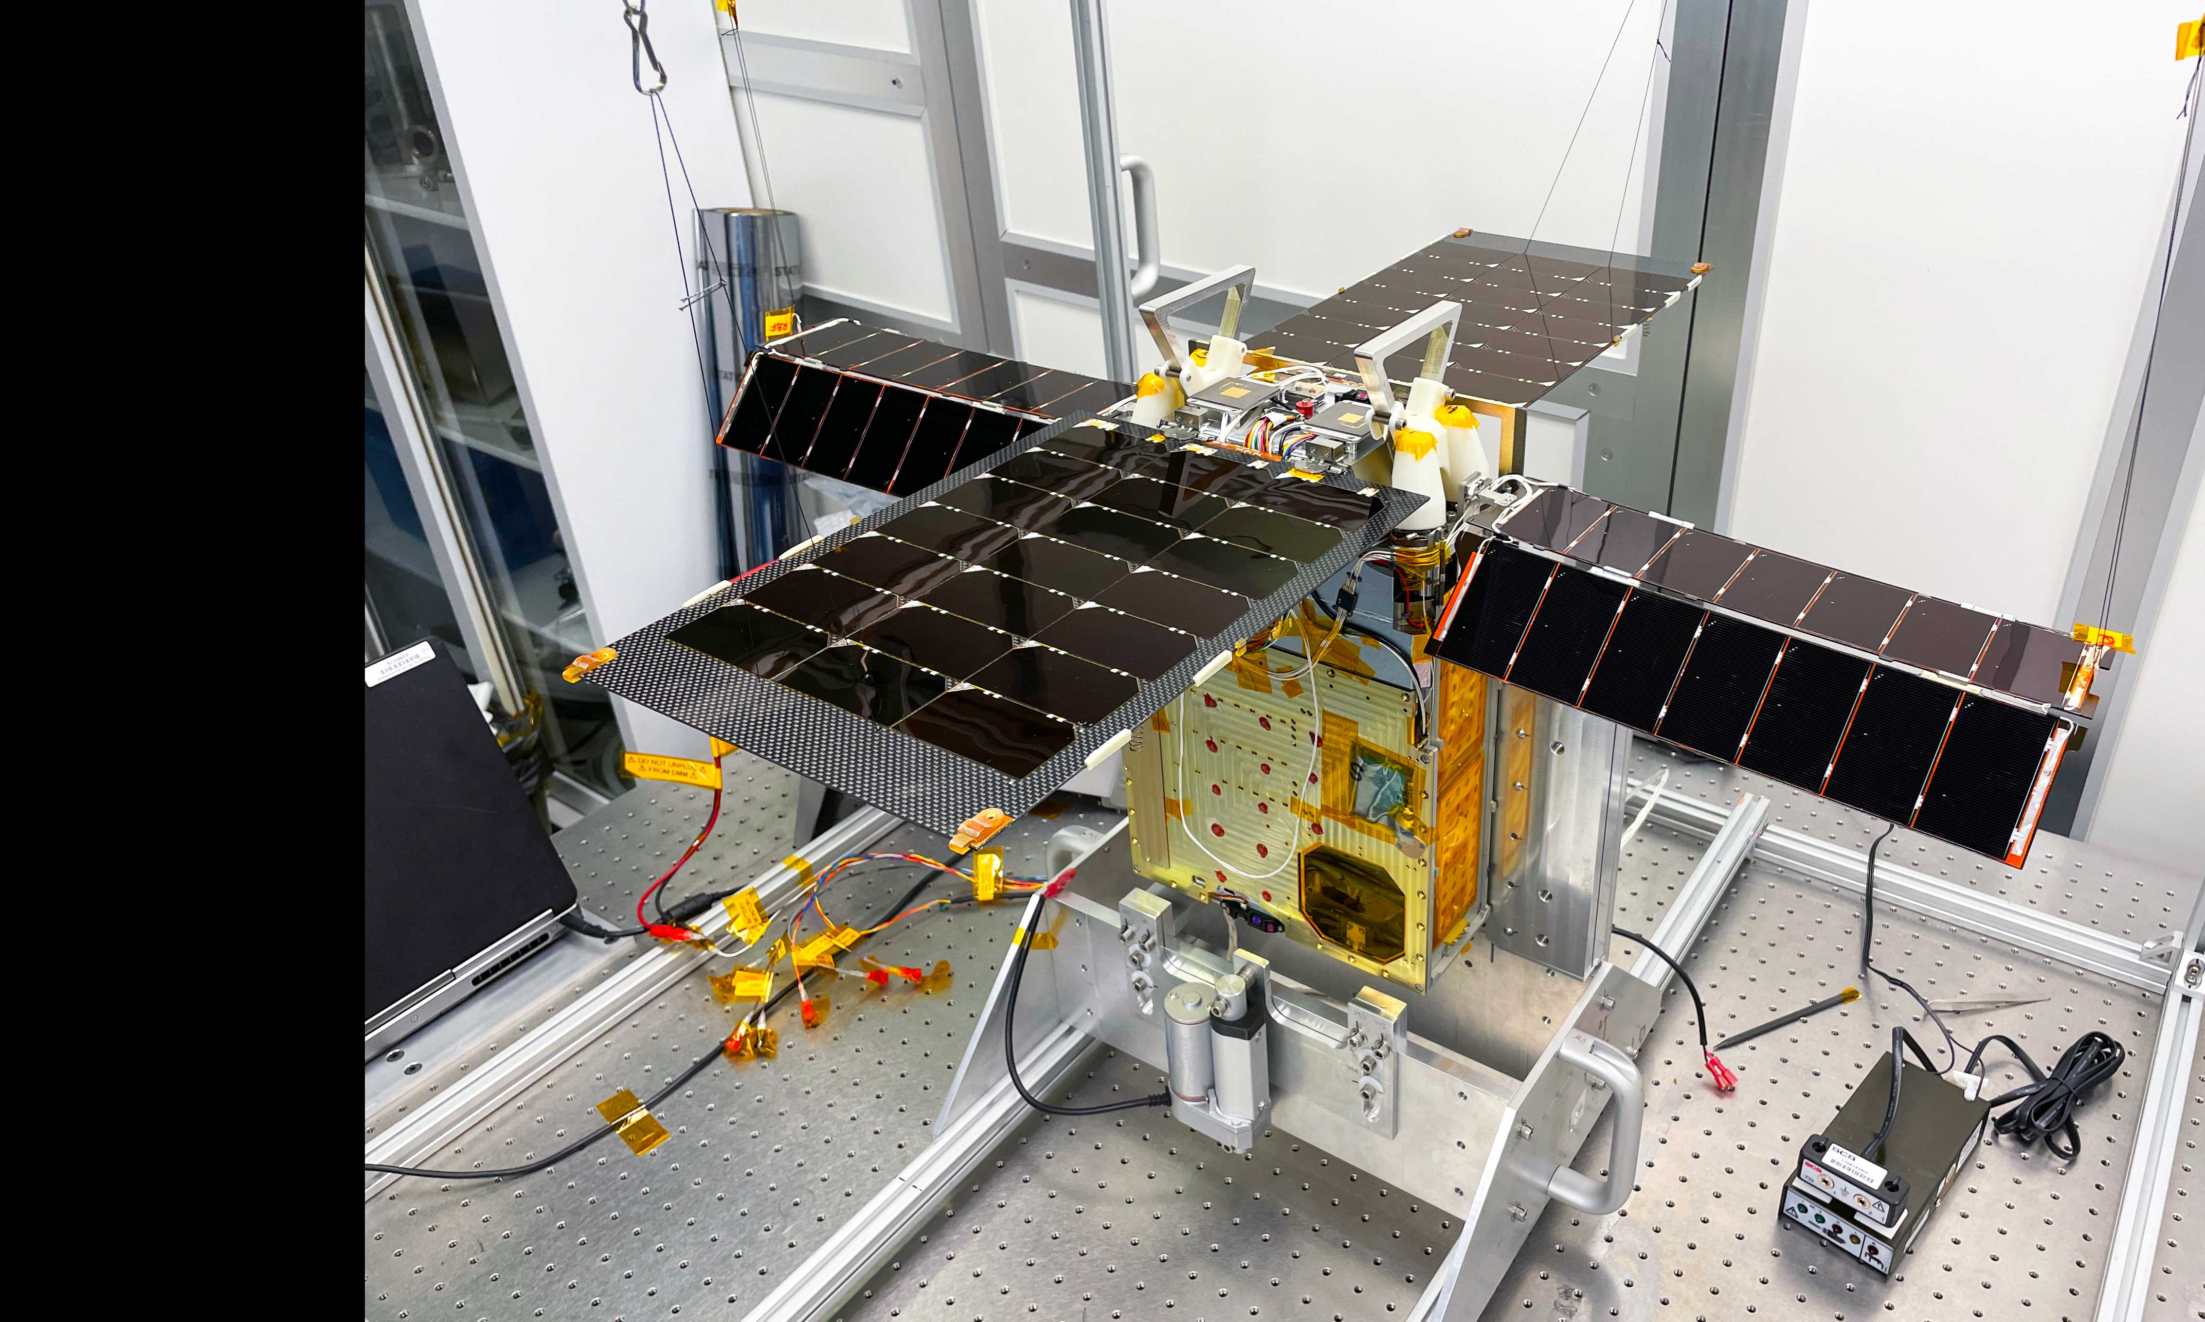
Project Background
Edward Zapert
Green Propellant
Current Uses
GPIM Tech demonstration Mission
Cheaper and safer than hydrazine
Requires less fuel onboard
Lunar Flashlight CubeSat mission to map ice on the moon
Notes:
new alternative to typical rocket fuel SA hydrazine
Of interest because it is cheaper and safer than what is currently used
This new propellant has only been part of a few missions those being:
Lunar south pole

Slide 6
Key Design Requirements
Aidan Hoolihan
Measurement
Micro-thrust measurement (0.1N)
Avoid environmental noise
Identify and quantify error
Provide accurate measurements (±0.01N)
The design should be capable of isolating force exerted by the thruster and recording it with accuracy and associated error.

Slide 7
Key Design Requirements
Aidan Hoolihan
Safety
Divert heat from the thruster to a safe area
Green Propellant is corrosive (material concern)
Lightweight design to alleviate transportation
Minimize sharp edges/corners
Test for safety of the force sensor (temperature concern)
The design needs to be under 30lbs, made from a non-corrosive material, and contain a ‘flame bucket’ to divert heat.

Slide 8
Key Design Requirements
Aidan Hoolihan
Interfacing
Allocate space for wires/fuel lines
Use of terminal blocks to connect all electronics
Centralize data collection and processing with one system
Give real time feedback about the thruster's performance
Provide adequate housing to connect propellant lines, wiring, electronics, and interface with the design remotely using an Arduino.

Slide 9
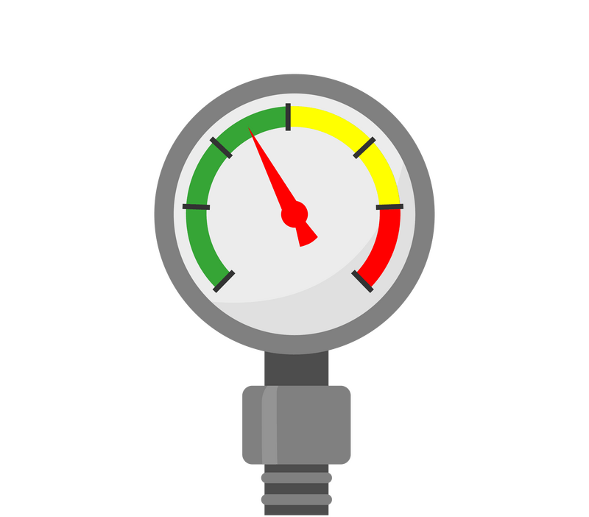
Key Design Requirements
Aidan Hoolihan
Environment
Testing is done in a vacuum environment (3e-6 Torr)
Little accessibility during testing
Vacuum entrance is small
All design components will be applicable in vacuum conditions, and the design must function remotely once placed in the vacuum chamber.

Slide 10
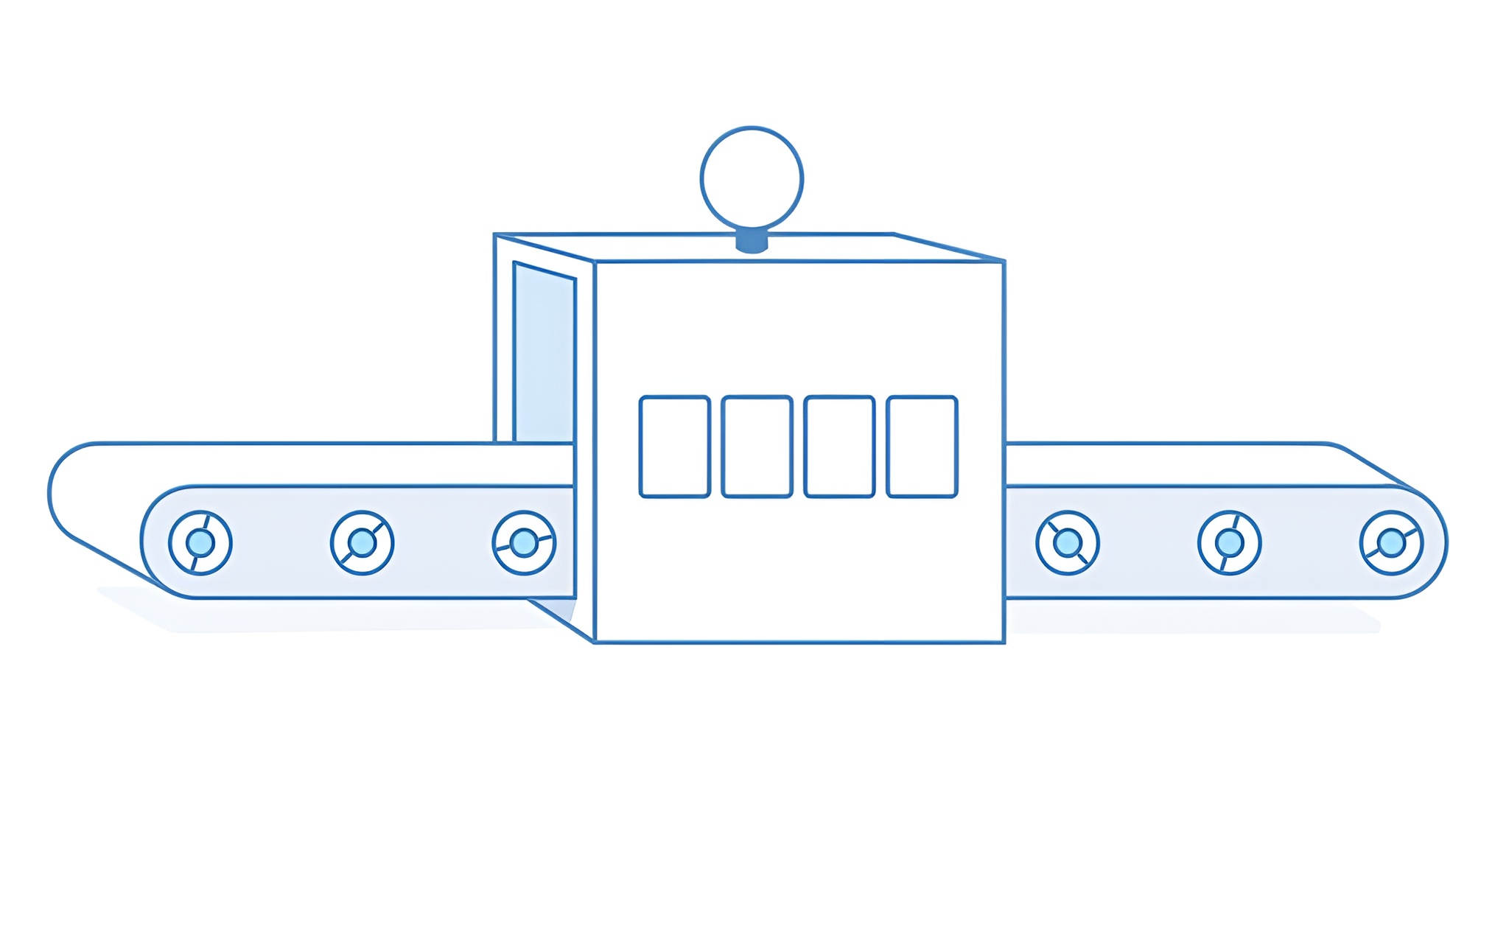
Design Process: Ideation
Aidan Hoolihan
Key Features
Ideas
Precise measurement
Calibrates Remotely
Error calculation
No larger than 12x18 in
Non-corrosive material
Lightweight
Easy to clean
Locking mechanism
Key characteristics for the thrust stand were identified through ideation and selection.
Methods used: Binary Pairwise, Pugh Charts, and House of Quality.
The process helped determine essential vs. flexible features.
Key features shaped the original design and its iterations.

Slide 11
Design Iteration #1
Nicholas Jensen
Pros
Cons
Low resonant frequency
Easy to clean
High visibility
Potential linkage rocking
Minimalistic, low cost
Unrealistic sizing
Flame Bucket
Calibration Mechanism
Vibrational Damping
Terminal Blocks

Slide 12
Design Iteration #2
Nicholas Jensen
Pros
High resonant frequency
Cons
Hard to manufacture
Sturdy calibration link
Modular
No realistic link pivot
Limited room near thruster to work
Sensor Mount
Thruster Linkage Mount
Structural Components
Calibration Linkage
Calibration Weight Module

Slide 13
Prototyping
Nicholas Jensen
Updates
Improved calibration method
Interchangeable sensor mounts
Designed bolt placement
Redesigned structure
Machinable
Optimized mounts
Thruster
Calibration weight
Bearings

Slide 14
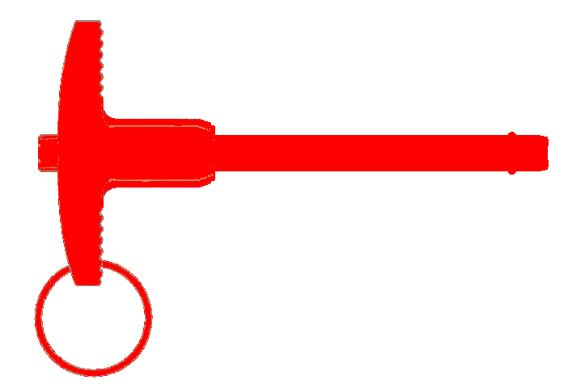
Prototyping
Nicholas Jensen
Problem Areas
Undersized Counterweight Placeholder
Interference
Interference
Locking Pin Interference with A Frames (Blue)
Machine Shop Cannot Tap #12-24
Locking Pin

Slide 15
Final Design
Nicholas Jensen
Updates
Moved pin location to behind the stand
Created an extrusion for NASA sized counterweights
Switched all #12-24 bolts to #10-24

Slide 16
Final Design
Nicholas Jensen
Spacers
Thruster Link Mount
Solenoid Valve
Thruster Block
Thruster

Slide 17
Final Design
Nicholas Jensen
WIKA Force Sensor
Sensor Mount
Bearing Mounts
Counterweight Extrusion

Slide 18
Final Design
Nicholas Jensen
Linkage Bolt Pivot
Locking Pin

Slide 19
Final Design
Nicholas Jensen
Calibration Weight Hook
Servo: Platform Rotation
Weight Applying Platform
Stepper: Platform Raising

Slide 20
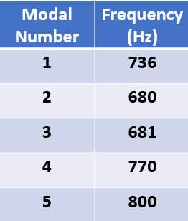
Design Validation: Modal Analysis
Ryan Kaczmarczyk
Design Goal: Create stand with resonant frequencies around 700Hz
Final Results
Run Modal Analysis
Once
f ≈ 700 Hz
Initial Design
$\sqrt{\frac{k}{m}}$

Slide 21
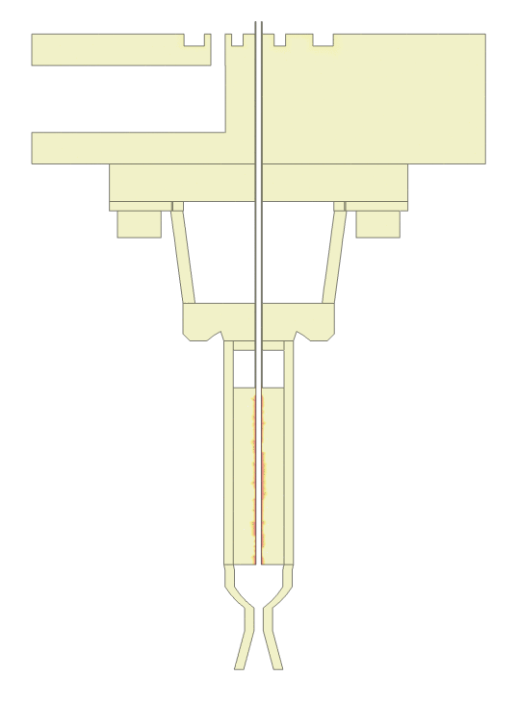
Design Validation: Thermal Analysis
Ryan Kaczmarczyk
Design Goal: Model heat transfer from thruster to validate sensor placement
Dual Heat Sources
Thruster and Solenoid
30 Second Steady Thruster Fire
Key
- Tungsten Core
- Rhenium Body
Results after 30 seconds
- Titanium Mount
- 304 S.S. Block
Maximum Contact Temp of 20ºC

Slide 22
Stand Operation – User Interface
Ryan Kaczmarczyk
Control Unit
Vacuum Chamber

Slide 23
Stand Operation – User Interface
Ryan Kaczmarczyk
Control Unit
THRUST STAND V1.0
press to continue
4X20 LCD SCREEN
“STOP TEST” Button
Navigational Buttons

Slide 24
Stand Operation - Preloading
Jeffrey Hill
Apply Counterweight

Slide 25
Stand Operation - Preloading
Jeffrey Hill
Apply Counterweight

Slide 26
Stand Operation - Preloading
Jeffrey Hill
Apply Counterweight

Slide 27
Stand Operation - Calibration
Jeffrey Hill

Slide 28
Stand Operation - Calibration
Jeffrey Hill
Counterweight
Thrust Sensor
Thruster
Force (mN)
Loading Mechanism
Volts (V)
Zero the Sensor

Slide 29
Stand Operation - Calibration
Jeffrey Hill
Counterweight
Thrust Sensor
Thruster
Force (mN)
Loading Mechanism
Volts (V)
Apply Known Mass

Slide 30
Stand Operation - Calibration
Jeffrey Hill
Counterweight
Thrust Sensor
$$\frac{mN}{V}$$
Thruster
Force (mN)
Loading Mechanism
Volts (V)
Establish Calibration Relationship

Slide 31
Stand Operation - Calibration
Jeffrey Hill
Counterweight
Thrust Sensor
Thruster
Force (mN)
Loading Mechanism
Volts (V)
Unload Mass

Slide 32
Stand Operation - Calibration
Jeffrey Hill
Counterweight
Thrust Sensor
Thruster
Force (mN)
Loading Mechanism
Volts (V)
Unload Mass

Slide 33
Stand Operation – Test Fire
Jeffrey Hill
Counterweight
Thrust Sensor
Steady State Fire
Thruster
Force (mN)
Loading Mechanism
Time (s)

Slide 34
Stand Operation – Test Fire
Jeffrey Hill
Counterweight
Thrust Sensor
Pulsating Fire
Thruster
Force (mN)
Loading Mechanism
Time (s)

Slide 35
Stand Operation – Results
Jeffrey Hill
Live Results are Displayed
Generated Error
Type | Source(s)
Calibration (Systematic) | Machining, Instrumentation
Data Acquisition (Systematic) | Sensor Output, Amplification, ADC
Testing (Random) | Thruster Variability
100.00 $±$ xx.xx mN
LCD Screen
** Cold Gas Thrust Tests will be conducted from 04/03 – 04/04 at NASA-MSFC
SD
Results Written to an SD Card

Slide 36
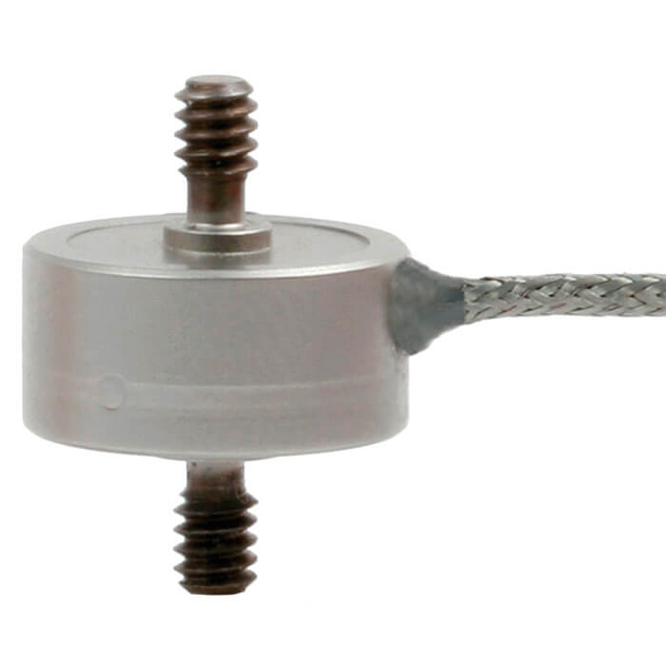
Budget Breakdown
Edward Zapert
FAMU-FSU Engineering
Supplied by Sponsor
WIKA Model F2221 Force Transducer ($1500)

Slide 37
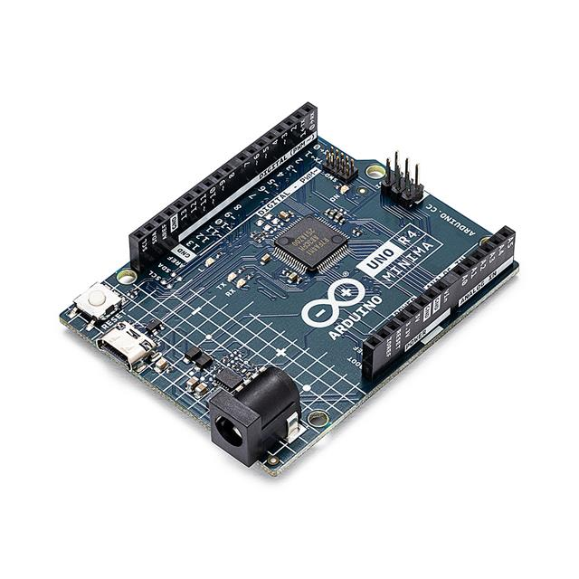
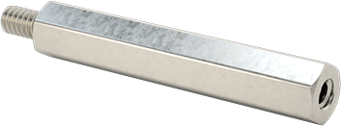
Budget Breakdown
Edward Zapert
Raw Material
Hardware
Bearings
Mechatronics
304 Stainless Steel Plating
Screws, Standoffs, DIN Rail
Ceramic Bearings, Lubricant
Arduino, Switches, Wires
$896.26
$134.76
$120.44
$112.67

Slide 38
Lessons Learned
Aidan
Stakeholder Communication, Task Tracking
Jeffrey
Nicholas
Team 517
Sponsor Communication, Task Tracking
Budgeting, Faculty Communication
Ryan
Edward
Part Delays, Scope Clarification
Sponsor Communication, Task Tracking

Slide 39
Lessons Learned
Aidan Hoolihan
Aidan
Stakeholder Communication
Its possible to overcommunicate
Don’t wait for the meeting, email!
Take advantage of stakeholder resources
Task Tracking
Expect and adapt to delays
Self assigned deadlines hurt
Keep the team aware of tasks
Switching gears so work is consistently done
Jeffrey
Nicholas
Team 517
Ryan
Edward

Slide 40
Lessons Learned
Nicholas Jensen
Aidan
Jeffrey
Nicholas
Design Communication
Verify materials and ideas with machine shop
Gather feedback from stakeholders
Prototypes are invaluable
Can visualize design
Provide hands-on use
Identify physical errors
Brainstorm new possibilities
Team 517
Ryan
Edward

Slide 41
Lessons Learned
Edward Zapert
Aidan
Jeffrey
Nicholas
Budget Management
Small costs add up
Finding a balance between quality and cost
Timeliness of ordering parts
Faculty Communication
Keeping close contact to help avoid delays
Preventing miscommunication by submitting orders properly
Team 517
Ryan
Edward

Slide 42
Lessons Learned
Ryan
Kaczmarczyk
Aidan
Jeffrey
Nicholas
Parts May Have Delays
Order Parts Early
Have a Backup Plan
Clarify Your Scope
Ensure your team and your sponsors are on the same page
If narrowing is needed, the sooner the better
Team 517
Ryan
Edward

Slide 43
Lessons Learned
Jeffrey Hill
Aidan
Jeffrey
Nicholas
Managing Expectations
Scope creep can lead to delays
Future work is necessary
Accountability
Learning to trust teammates
Leaning on stakeholder advice
Personal Growth/Time Management
Projects can force you to learn new skills
Projects have up and down times
Team 517
Ryan
Edward

Slide 44
Quick Recap
Edward Zapert
Background
Green propellant is safer and more efficient than hydrazine
Design Validation
Modal analysis ran to verify natural frequency
Accurately measure the thrust of a 0.1N green propellant thruster
Key Goals
Minimize uncertainty
Remotely calibrate under vacuum
Thermal analysis ran to verify temperature output near sensor
Vacuum Conditions
Remote Calibration
ASCENT
NASA MSFC
FAMU-FSU COE

Slide 46
Slide Headline
Try to keep text at 16 pt minimum.
Try to put as few words as possible on the slide if you’re using for a presentation.
Mix and match the backgrounds as shown in this template or just use one throughout.
You can put department/unit logos in slide master at Horizontal 0.89” Vertical 6.44” From top left corner

Slide 47
Font Check
This is 10-point
This is 15–point Times
This is 20–point
This is 25–point
This is 30–point
This is 35–point
This is 40–point
This is 50–point
This is 60–point
This is 72–point
Notes:
Use at least 20-point font in Room A105, B134, and B136
Use at least 25-point font in Room B135

Slide 48
College of Engineering Color Palette
1 2 3 4
Pantone: PMS 195 C
RGB: 120, 47, 64
Hex: #782F40
CMYK:19, 90, 50, 55
1 2 3 4
Pantone: Black C
RGB: 0, 0, 0
Hex: #000000
CMYK:0, 0, 0, 100
Garnet
Black
1 2 3 4
RGB: 238, 118, 36
Hex: #EE7624
CMYK:2, 66, 99, 0
1 2 3 4
Pantone: PMS 000C
RGB: 255, 255, 255
Hex: #FFFFFF
CMYK: 0, 0, 0, 0
Fang
Orange
White
Notes:
Avoid 75% Black in B135

Slide 49
Accent Color Palette
1 2 3 4
RGB: 0, 59, 111
Hex: #003B6F
CMYK:
1 2 3 4
RGB: 0, 59, 111
Hex: #003B6F
CMYK:
1 2 3 4
RGB: 251, 236, 93
Hex: #FBEC5D
CMYK:
1 2 3 4
RGB: 219, 215, 210
Hex: #DBD7D2
CMYK:
1 2 3 4
RGB: 251, 236, 93
Hex: #FBEC5D
CMYK:
1 2 3 4
RGB: 219, 215, 210
Hex: #DBD7D2
CMYK:
Tardis Blue
Tardis Blue
Corn
Timberwolf
Corn
Timberwolf
1 2 3 4
RGB: 206, 0, 88
Hex: #CE0058
CMYK: 0, 100, 43, 12
1 2 3 4
RGB: 206, 0, 88
Hex: #CE0058
CMYK: 0, 100, 43, 12
1 2 3 4
RGB: 104, 40, 96
Hex: #682860
CMYK:
1 2 3 4
RGB: 220, 220, 220
Hex: #DCDCDC
CMYK:
Rubine Red
Rubine Red
Imperial
Gainsboro
1 2 3 4
RGB: 72, 146, 155
Hex: #48929b
CMYK:
1 2 3 4
RGB: 64, 224, 208
Hex: #40E0D0
CMYK:
1 2 3 4
RGB: 255, 139, 0
Hex: #FF8B00
CMYK:
Asagi-iro
Turquoise
American Orange
Notes:
Remove American orange add hyperlink grey
Make corn the last for b135
All work in 134 imperial move later
Tardis doesn’t work in b136

Slide 50
F7AB19
D67F15
EE7624
D64615
F73119
Analogous
6E3610
F0A16C
EE7624
6E4931
BASB1C
Monochromatic
A14508
4BED3B
EE7624
250CED
2010A1
Triad
A1470C
FF8C40
EE7624
0098A1
24E2ED
Complementary
28A164
2FED8D
EE7624
0848A1
1871ED
Split Complementary
EDAC2F
3BED93
EE7624
0C6AED
ED2F18
Double Split Complementary
ED660C
C7ED3B
EE7624
0CE1ED
A418ED
Square
BA7E09
87724A
EE7624
60EFCF
09BA61
Compound
https://color.adobe.com/create/color-wheel
AD551A
6E3610
EE7624
FA7625
D46820
Shades
Notes:
These are the variants that work well with Fang Orange. The bolded items show well on the projectors.

Slide 51
85412D
8F3831
782f40
8F3176
792D85
Analogous
C44D69
8E626D
782F40
C48796
451B25
Monochromatic
C43959
78743B
782F40
236178
43A2C4
Triad
C43959
C46078
782F40
25C43D
2F783A
Complementary
93C460
577835
782F40
39C49D
297861
Split Complementary
784435
5A783B
782F40
237860
6E2978
Double Split Complementary
782337
78683b
782F40
237830
293978
Square
AB4D32
DEBAAF
782F40
5D8555
70AB32
Compound
https://color.adobe.com/create/color-wheel
38161E
C44D69
782F40
853447
5E2532
Shades

Slide 52
A105
A105
B135 Stage Left
B135 Stage Right
B136
B134, A105
B135

Slide 53
Border Line
Border Line
Border Line
Center of White Space
Center of Slide
Middle of Slide
Middle of White Space
Edge of Branding
Border Line
Notes:
Vertical lines from top down.
Borderline and top of title. (0.5 inch)
Center of Slide (0 inch y-direction for the entire slide)
Center of Design Content (0 inch y-direction considering the title, footer, and negative space)
Bottom of Design Content (0.25 in gap to the footer. 0.75 to the bottom of the screen)
Horizontal lines from left to right
Borderline (0.5 inch)
Center of design content.
Center of slide (0 inch y-direction for the entire slide)
Borderline (0.125 inch all around)

